Slide 1
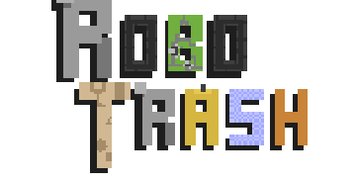
Final presentation

Slide 2

Team Members
Cárdenas Hernández Mauricio de Jesús.
Fernández Santiago Aurelio Adair.
Gómez Calvario Sebastián.
Gutiérrez Bejarano Braulio Roberto.
Nolazco Lagunas Carlos.
Valenzuela Martínez Gilberto.

Slide 3
Activities Schedule

Slide 4
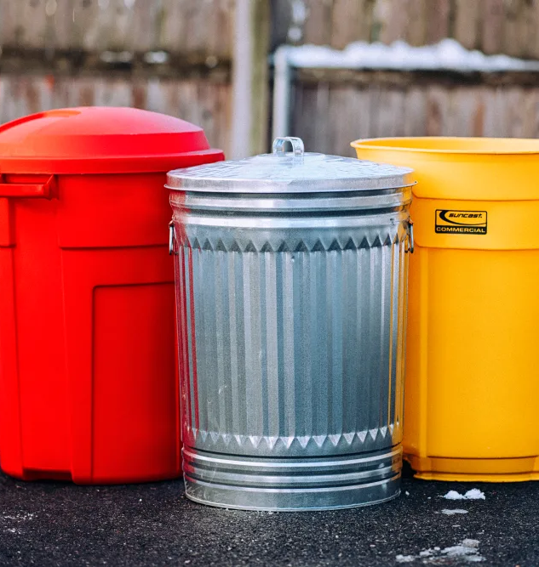


Main Objective:
What we wanted to achieve with this game was to get children's attention on a serious topic such as environmental pollution by teaching children the importance of how to divide trash correctly. We really poured our souls in this project to make an actual good game and not just something simple.

Slide 5

Overall team’s expectation
We wanted to make a good-looking children’s game, with good conceptual art and design, once we get children’s attention, we can now teach them a hard topic to understand at school, the topic we choose was recycling the trash since we believe is an important topic to cover nowadays.

Slide 6

Final results from the surveys.
The game was applied to 20 children between the ages of 10 and 12 at St. Johns Elementary School. These were the most important result of the applied survey.

Slide 7
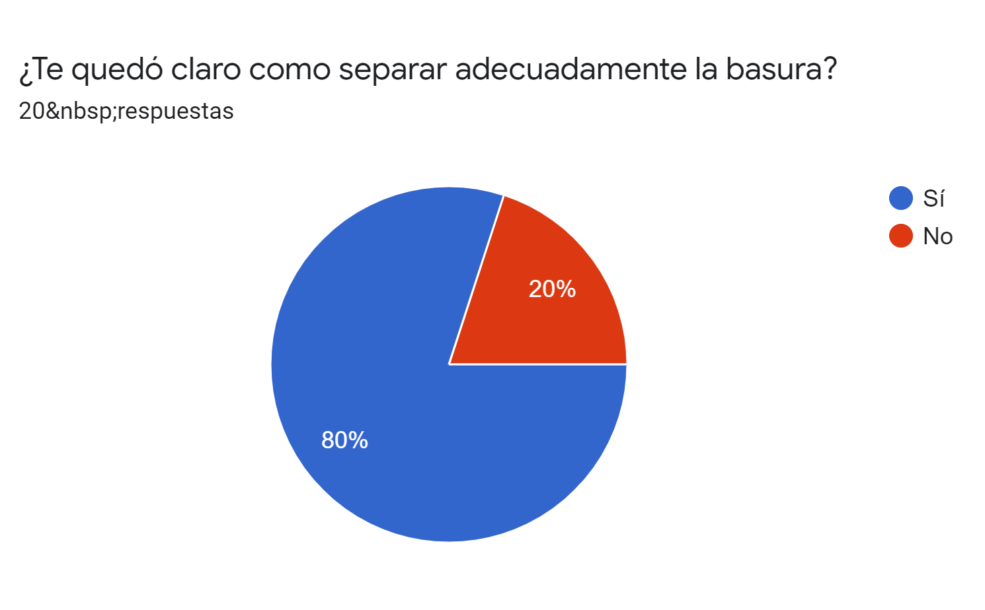
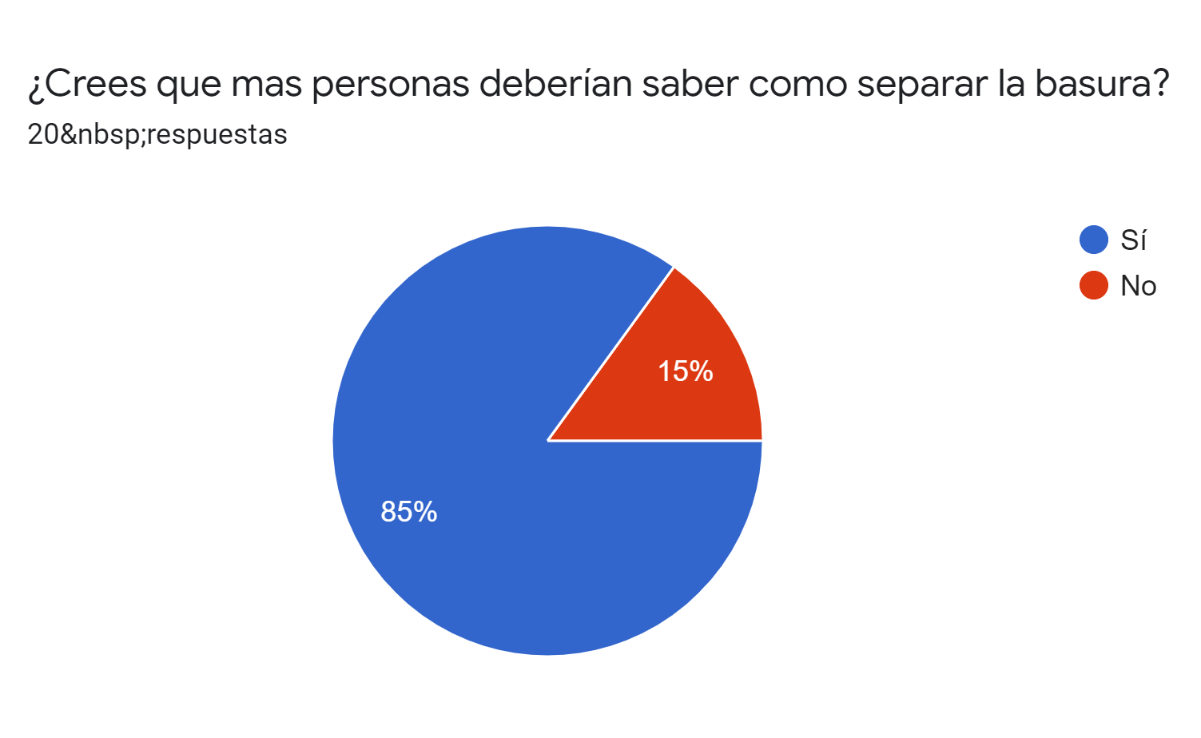
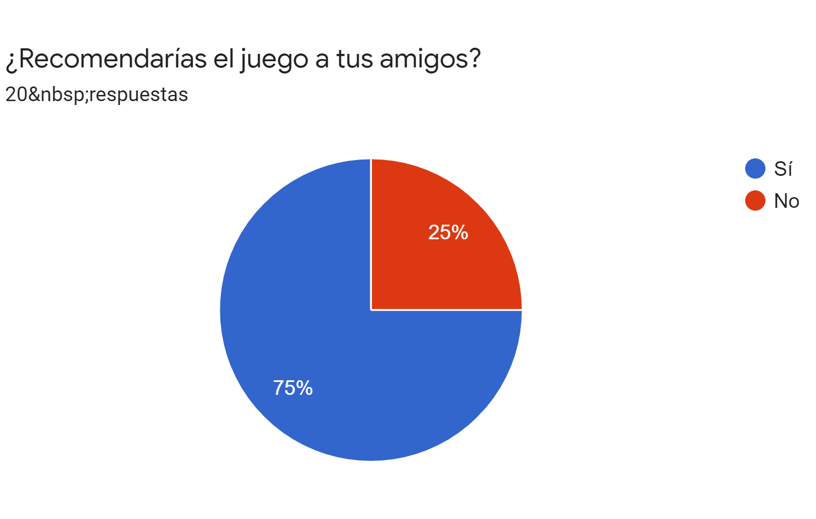
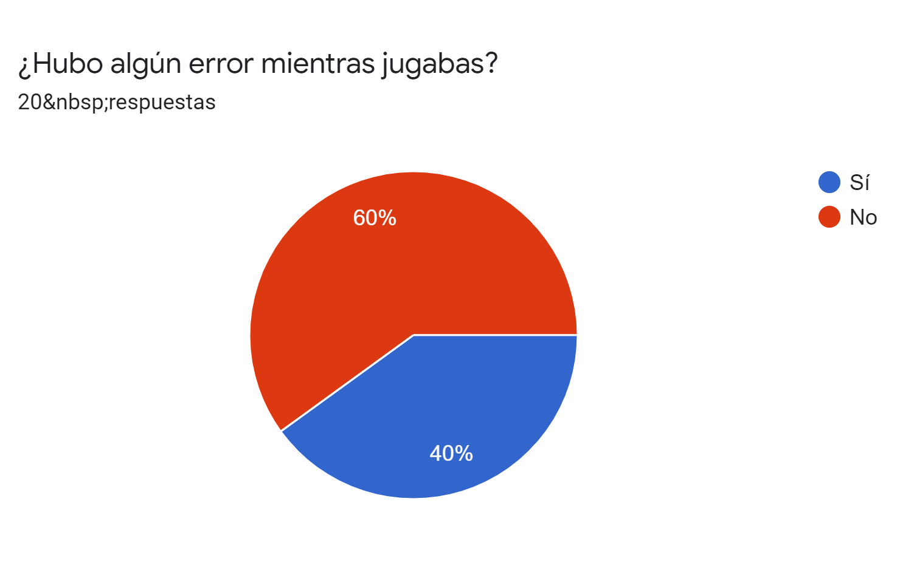

Slide 8

With this we can conclude that our game met our expectations of being functional and educational for children.

Slide 9

Conclusions
Through the development of this game, we learned a lot about the process of making something entirely from scratch, from the main idea to the game mechanics. We think this is a great opportunity for children to learn about these themes so they can work from a young age into making a change other than that, we hope robotrash help schools out there to better explain this subject and leave a mark on the youth.

